Slide 1
Accessing Digital Theological Library
Our licencing terms mean that only Faculty and UTC students can access the resources in Digital Theological Library (DTL)

Slide 2
DTL2 is searched from the Library Home Page. It is not integrated with Revelation

Slide 3
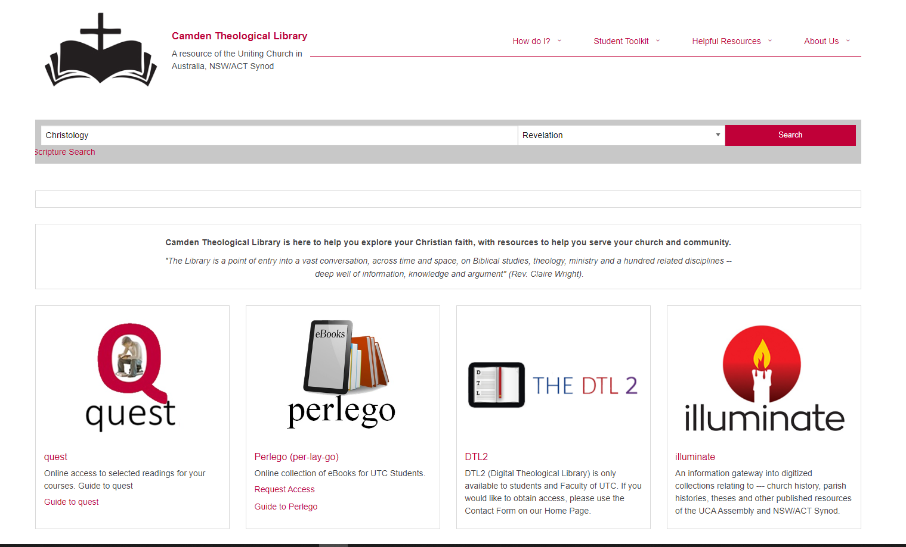

Slide 4
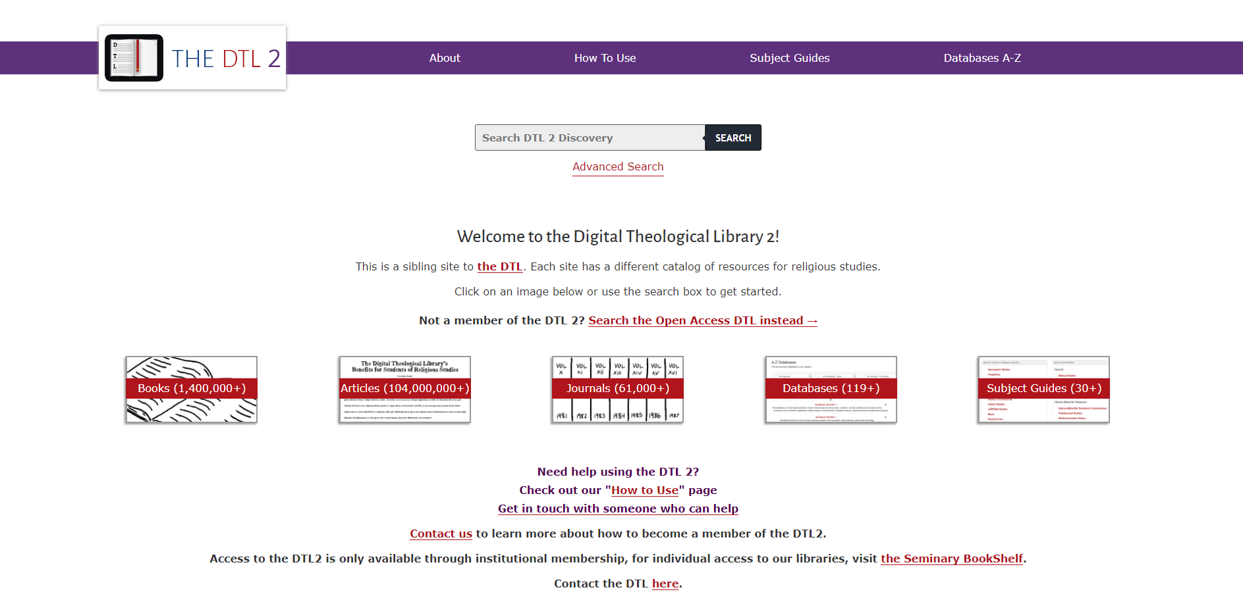
Click on the DTL2 Tab
Notes:
Click on the DTL2 Tab

Slide 5
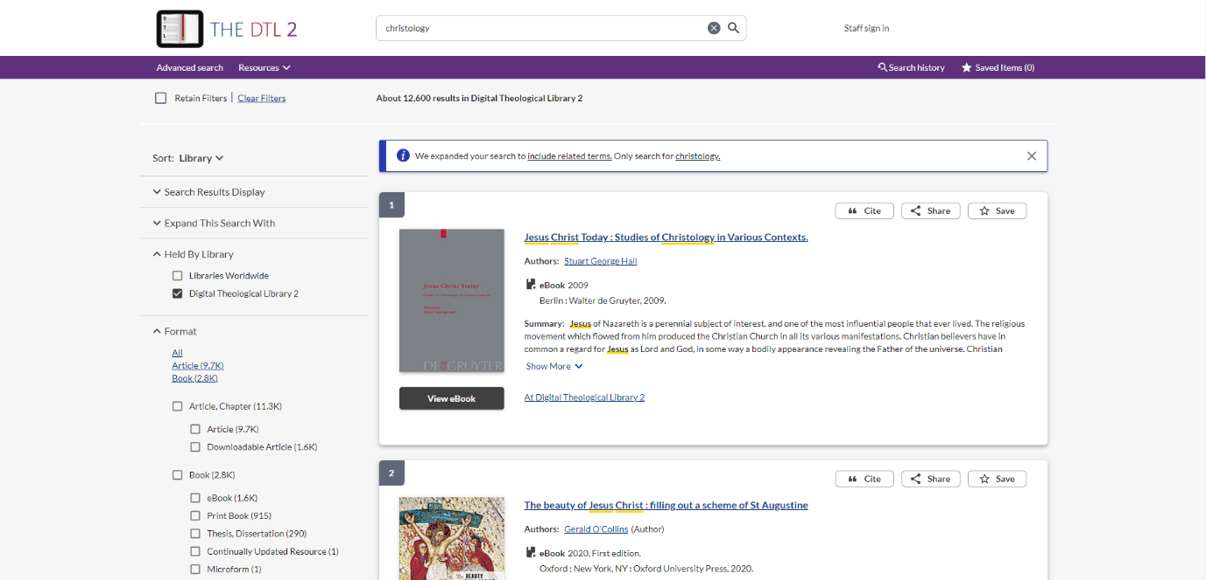
Search
for your
topic example - Christology
Notes:
Search for your topic eg Christology

Slide 6
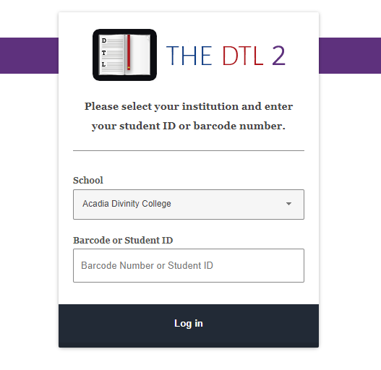
When you decide to access a book from DTL2 you will be taken to a screen like this…
Your library membership number will not work for these resources.

Slide 7
If you have not requested access to DTL2, please send an email via the Contact Us form on the Library home page, asking for permission to access DTL2.
https://www.library.nsw.uca.org.au/contacting-us/contact-us

Slide 8
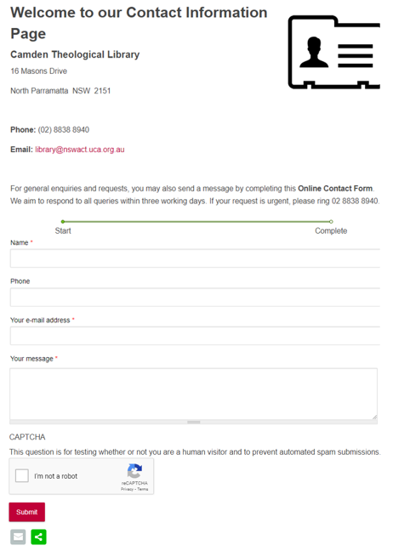
Contact Us
When this form has been submitted, Camden Theological Library will send you the necessary code via email to enable you to access eBooks via DTL 2.

Slide 9
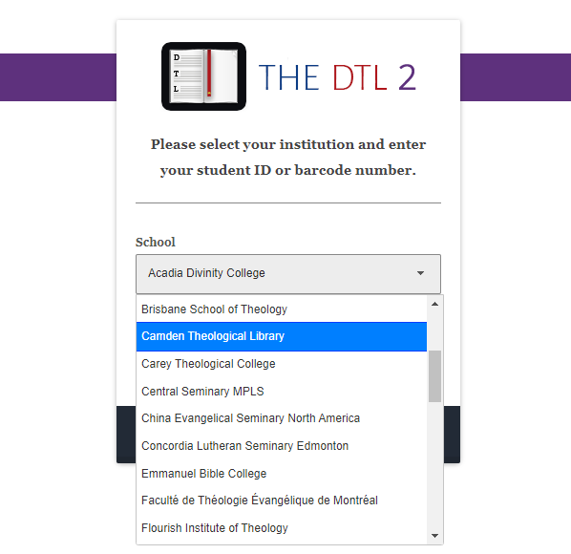
Once you have been given the access code, you will be taken to a screen where you select Camden Theological Library from the drop-down list and then enter the code you have been sent.
Don’t enter your library membership code:enter the code you have been sent.
You will now be able to access the eBook.

Slide 10
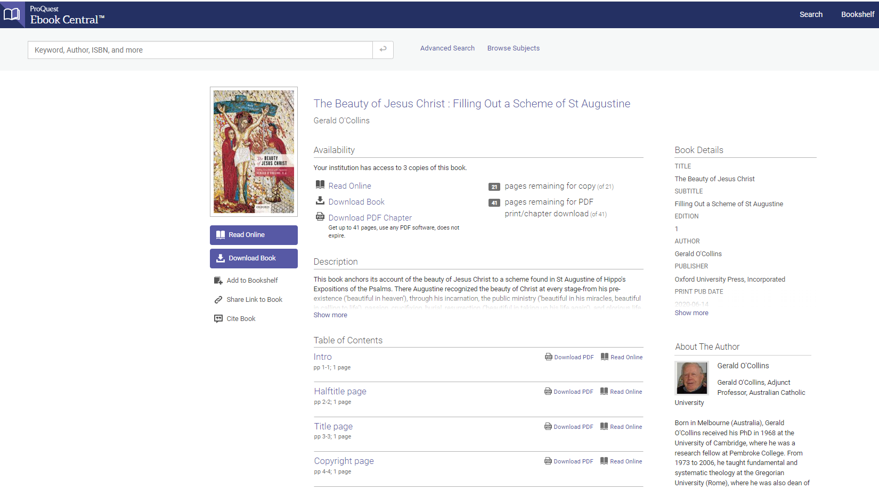

Slide 11
Additional authentication?
Because DTL2 draws material from over 1000 Collections, some Publishers request an additional level of authentication.
The next few screens will show some examples of this and what you need to do.

Slide 12
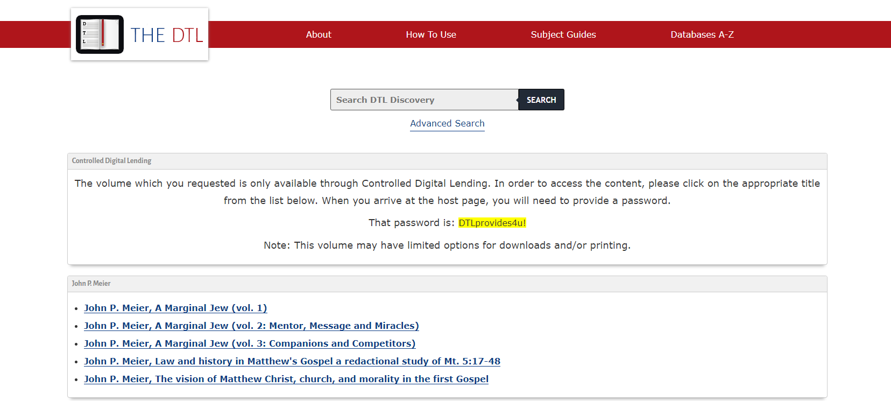
If you see this, you may need to enter this DTL password in the next screen.

Slide 13
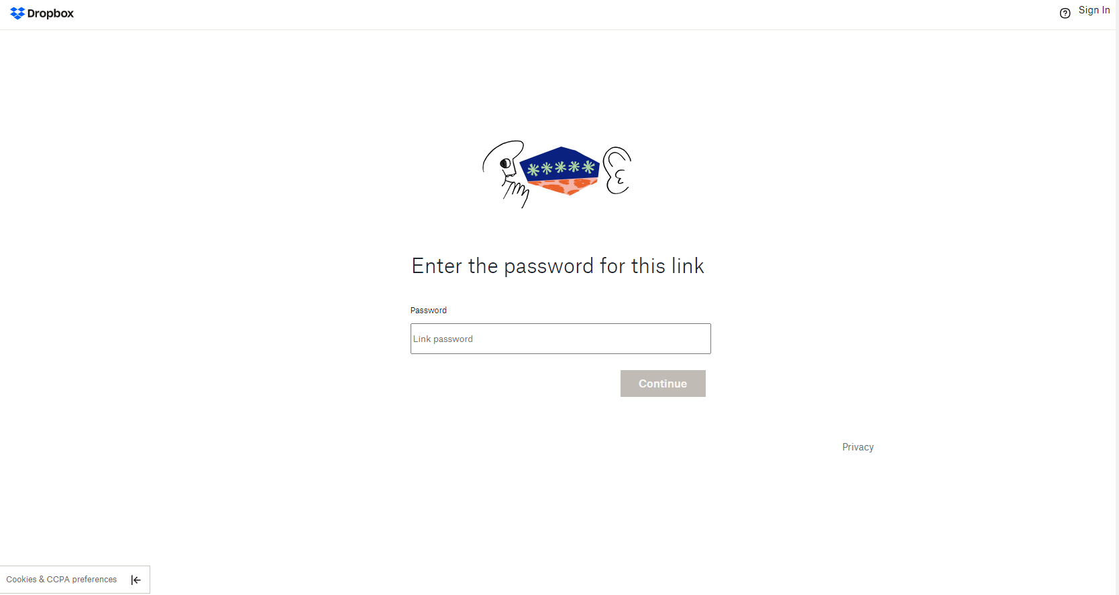

Slide 14
If you see a screen like this, you need to select ‘Digital Theological Library - Australia’

Slide 15
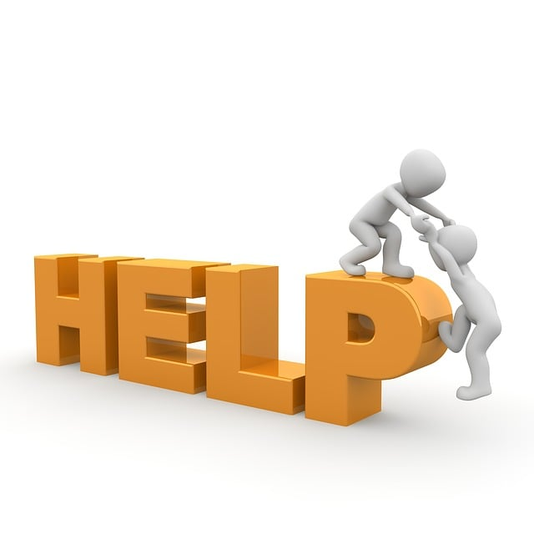
Would you like more Help?
Notes:
Would you like more Help?

Slide 16
We hope this has provided you with an overview of how to search for eBooks in ‘Revelation’. Please contact the Library if your need some additional assistance.
Email library@nswact.uca.org.au
Phone 02 8838 8940
You can contact the Library team by email or phone, and we will be happy to assist you

