Slide 1
This resource provides an introduction to locating and accessing EBSCO eBooks.
Searching for
EBSCO eBooks using
Revelation
Notes:
This resource provides an introduction at the new version of ‘Revelation’, the way results are displayed and some new features which are available.
When you search Revelation you can locate Print books, eBooks and Full Text Journal articles.

Slide 2
Before you begin…
Please follow the series of slides about
Searching Revelation
to understand the basic knowledge
you need to search Revelation

Slide 3
Revelation provides access to a range of resources.
When you search for eBooks in ‘Revelation’, the results will be taken from several Collections which have been made available (integrated) in ‘Revelation’.
This gives you a ‘one stop’ search experience.

Slide 4
The main integrated Collections are…
eBooks for which the Library has purchased from EBSCO
eBooks which are retrieved from a large collection called ‘Perlego’.
There is a separate set of slides explaining how to access eBooks from Perlego

Slide 5
How to Access

Slide 6
these eBooks are identified as Database : All EBSCO eBooks
When you carry out your search in
Revelation

Slide 7
Access Revelation from the Library website https://www.library.nsw.uca.org.au/

Slide 8
You begin your search by typing Keywords in the Search box. Keywords can be words from a Title, a Subject (Topic) or a combination of words from a Title and the name of an Author.

Slide 9
For example… If you are searching for eBooks about ‘converting witness’, enter
converting witness Then select ‘Search’ or press ‘Enter’

Slide 10
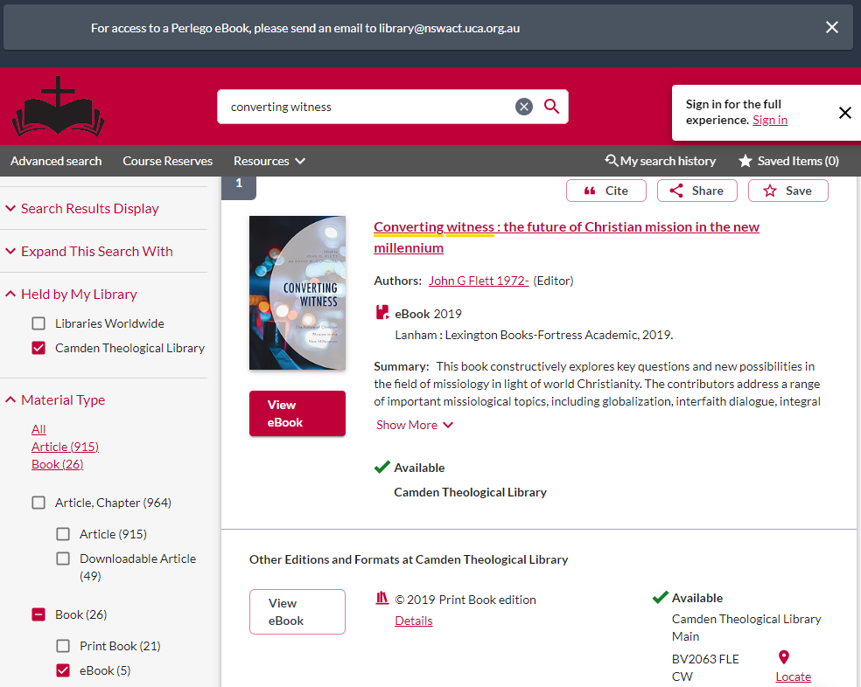
Identifying and Accessing an eBook
If you are looking for an eBook, you can use the Material Type filter options in the Left Hand column.
To filter by Material Type you tick the eBook box This shows the number of eBooks available.

Slide 11
Click on View eBook…
You will be taken to a Log in screen to allow you to Authenticate (sign in).
Different eBook collections require different Authentication methods.

Slide 12
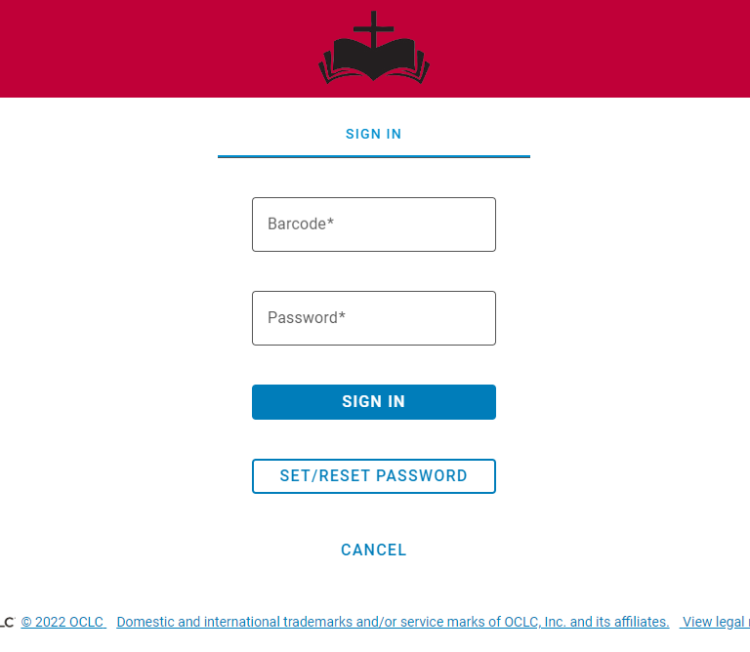
For EBSCO eBooks, you will be asked to
SIGN IN
via this screen:
Enter your Library barcode and your password and click Sign in.
If you have not set up or forgotten your Password, click on SET/RESET PASSWORD
You will receive instructions via an email to set up or reset your Password.

Slide 13
If you have problems setting up a Password, please send an email via the Contact Us form on the Library home page, asking for instructions to be sent to you.
https://www.library.nsw.uca.org.au/contacting-us/contact-us

Slide 14
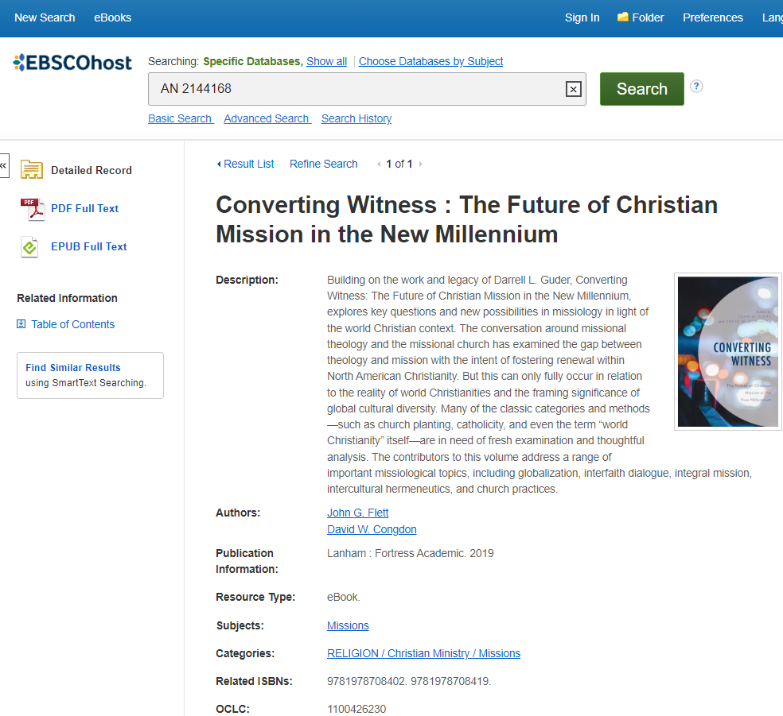
Once you have signed in (authenticated) you will be taken to this page. You can - read the eBook online - download sections - view the Table of contents. You may access it via these links:
- PDF Full Text (to read online)
- EPUB Full Text (to read online)
- Table of Contents (to navigate directly to a chapter or section to read online or download

Slide 15
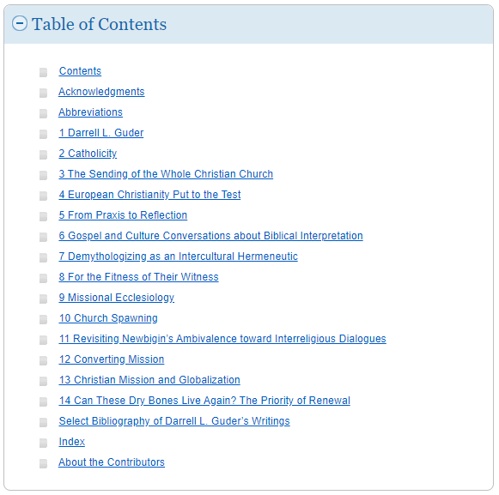
If you select the Table of Contents, You can choose a chapter or section by clicking on the hyperlink.
This will take you directly to that chapter or section.

Slide 16
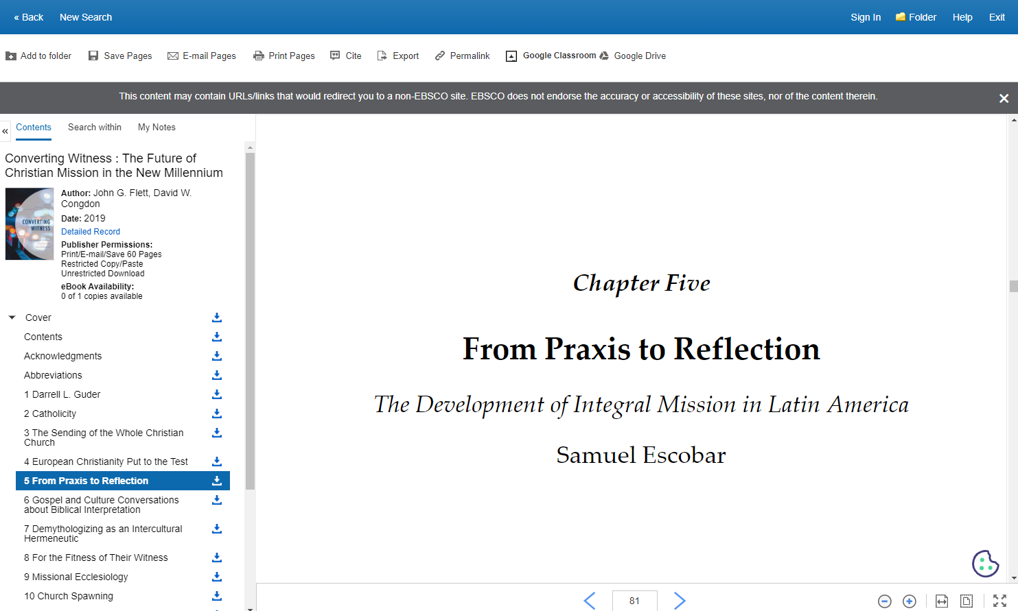

Slide 17
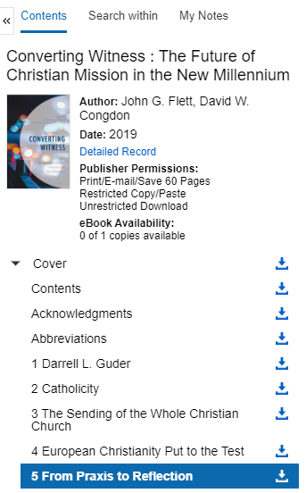
The Publisher Permissions indicator displays the number of pages that can be printed or saved, whether copy/paste functionality is allowed, and whether the eBook can be downloaded to read offline. When printing and saving is allowed, the number of available pages is updated as you print or save eBook pages to your computer.
The eBook Availability indicator displays the number of copies currently available from your institution.
Click the Download icon to download a chapter of the eBook title you are viewing

Slide 18
Would you like more Help?
Notes:
Would you like more Help?

Slide 19
We hope this provided you with an overview of how to search for some eBooks in ‘Revelation’. Please contact the Library has if your need some additional assistance.
Email library@nswact.uca.org.au
Phone 02 8838 8940
You can contact the Library team by email or phone, and we will be happy to assist you

