Slide 1
Searching for material relating to a verse in Scripture using Revelation

Slide 2
During your studies, you may be asked to write an exegesis on a particular Bible Passage.
Or perhaps you are preparing to preach and would like to know more about a passage.
While Bible commentaries and lectionary resources are a good place to visit, you can also find useful online resources by using the Scripture Search function in Revelation.

Slide 3
Scripture Search
Below the Revelation search box on the Library home page https://www.library.nsw.uca.org.au/ there is a link to Scripture Search

Slide 4
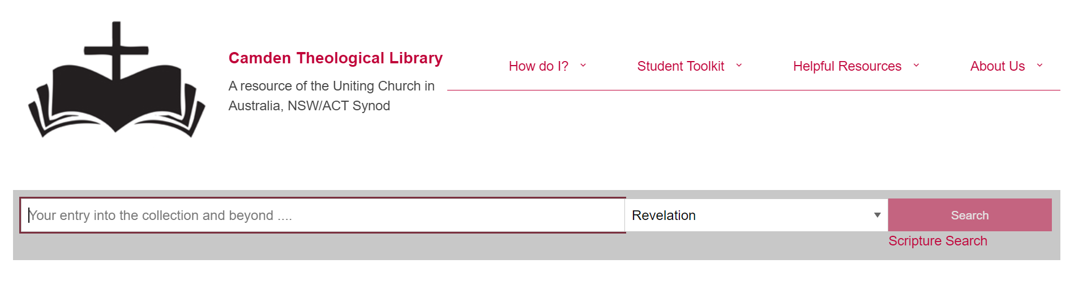
Click on Scripture Search

Slide 5
If you click on the Scripture Search link, click on Select a Book and a list of the books of the Bible is displayed. Select the book.

Slide 6
After selecting a book, select a chapter, then (perhaps) a verse, then ‘Submit’.

Slide 7
Often, if you are looking at a passage, it is better just to search for the book and chapter.
If you limit the search to a specific verse, you may miss out on articles which include the verse in the surrounding passages.

Slide 8
To complete the process, you
need to select ‘Search’

Slide 9
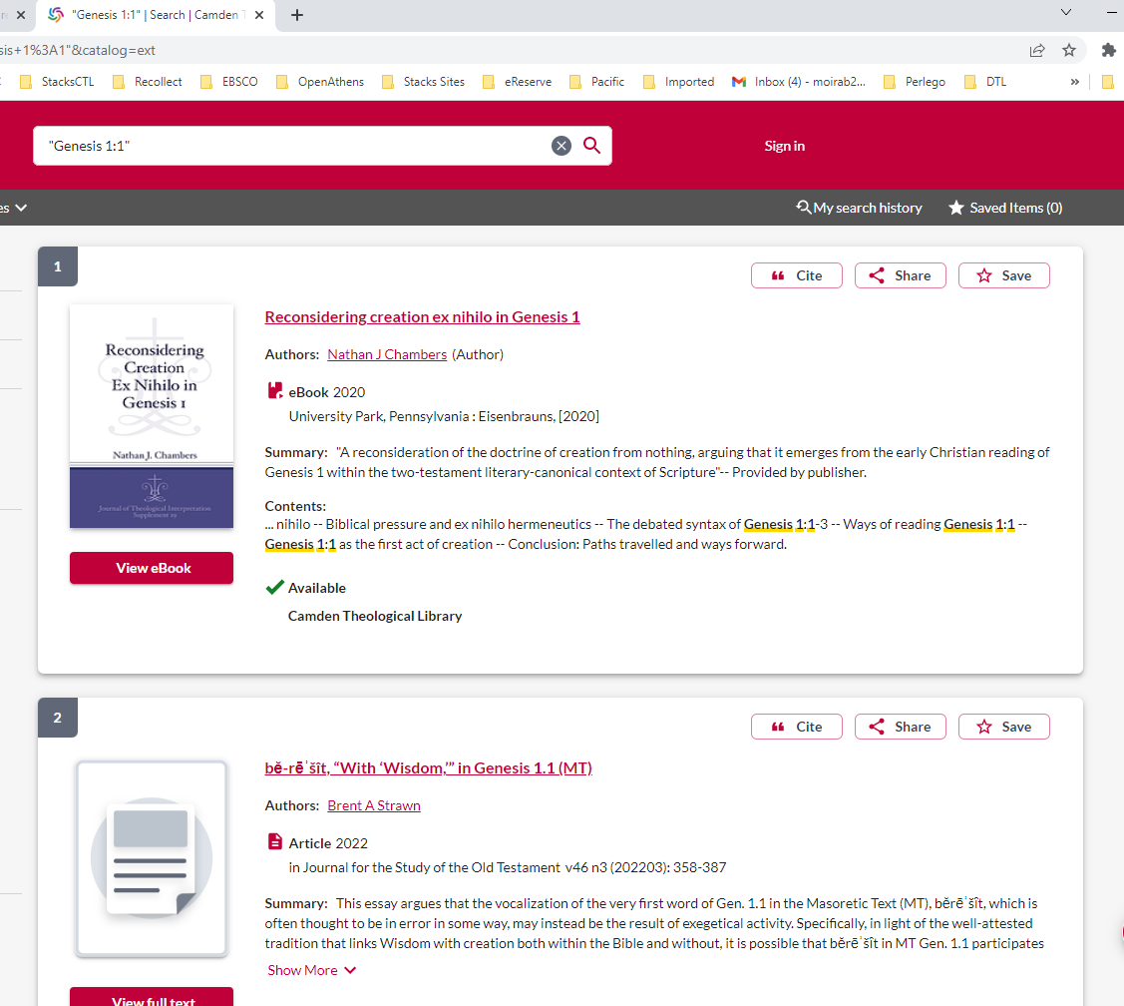
Revelation will retrieve relevant books and full text articles

Slide 10
If you are looking for an article, filter by ‘Downloadable Article’ and click on ‘View full text’

Slide 11
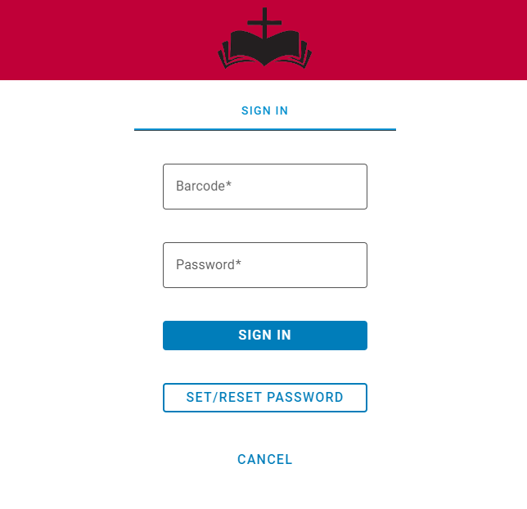
When you are asked to log in via this screen:
Enter your Library barcode and your password and click Sign in.
If you have forgotten your password, you can reset it. You will receive instructions via an email.

Slide 12
If you have not set up a Password, please send an email via the Contact Us form on the Library home page, asking for instructions to be sent to you.
https://www.library.nsw.uca.org.au/contacting-us/contact-us

Slide 13
To read the article, select ‘PDF Full Text’ or ‘HTML Full Text’

Slide 14
You can Print or email the article using one of the icons in the Right Hand column

Slide 15
If you wish to carry out another Scripture Search you will need to return to the Library home page by clicking the logo at the top of the screen.

Slide 16
Would you like more Help?
Notes:
Would you like more Help?

Slide 17
We hope this has provided you with an overview of how to do a ‘Scripture Search’. Please contact the Library if your need some additional assistance.
Email library@nswact.uca.org.au
Phone 02 8838 8940
You can contact the Library team by email or phone, and we will be happy to assist you

