Slide 1
This resource is an introduction to searching in ‘Revelation’, the way results are displayed and some other features which are available. When you search Revelation you can locate Print books, eBooks and Full Text Journal articles from one search. There are separate sets of slides which help you to access eBooks and Full text Journal articles.
Searching Revelation

Slide 2
You access Revelation from the Library website https://www.library.nsw.uca.org.au/

Slide 3
Searching for a book by an Author #1
Let’s begin by searching for a book for a particular Author. Your Subject Outline often contains details of books to support your study.
Notes:
Searching for a book by an Author
Let’s begin by searching for a book for a particular Author. Your Subject Outline often contains details of books you may wish to use to support your study.

Slide 4
You begin your search by typing Keywords in the Search box. Keywords can be words from a Title, a Subject (Topic) or a combination of words from a Title and the name of an Author.

Slide 5
We will search for books on ‘Christology’ by Alistair McGrath. Enter: Christology McGrath Then select ‘Search’ or press ‘Enter’

Slide 6
A number of Records are retrieved. The first record is for a print book, and it shows:
The details of the book –
Title
Author
Publication details
Summary
Whether it is Available to borrow or Checked out and the date it is due back.
The Call Number which shows where it can be found on the shelves.
If you click the ‘Locate’ link it will help you to find the location of the book

Slide 7
If the ATLA pop-up appears, you can move it away by clicking on the Arrow. This database will identify additional Full Text journal articles.

Slide 8
If you click on the Locate link, a floor plan of the Library will be displayed to help you to find the book.
The floor plan shows you on which row of shelves you can find the book.
It also displays the Call # for the book in the Left Hand section of the screen.

Slide 9
Searching for a book by an Author #2

Slide 10
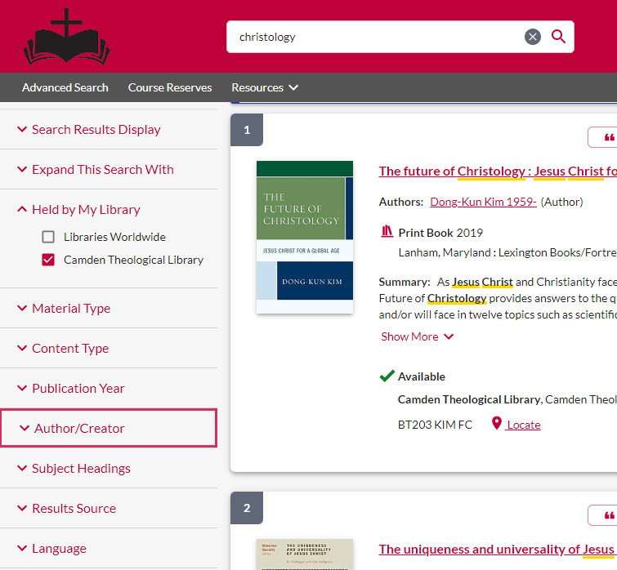
A second way to find a book by a particular Author is to search for topic, such as Christology and then to filter all the results using ‘Author/Creator’
On the results page, scroll down the Left Hand column until you reach ‘Author/Creator’ and click on this.

Slide 11
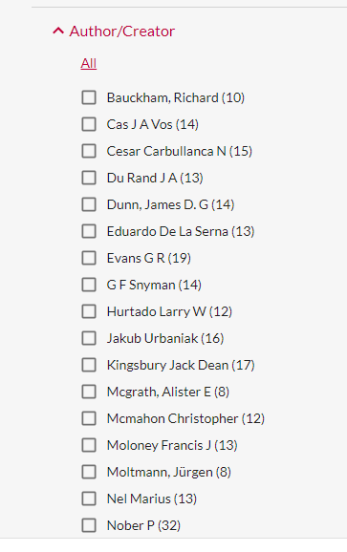
Details of all the relevant Authors are displayed in an alphabetical list with the number of records available.
You can then select their books by clicking on the box beside their name.

Slide 12
Searching for a book by an Author #3

Slide 13
The third way you can limit your search results is to click on the hyperlink for the Author’s name in a record.

Slide 14
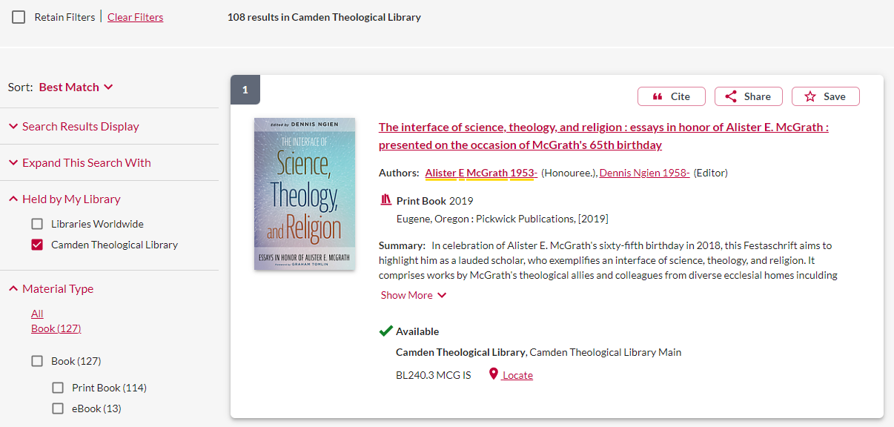
This will retrieve all the books written by that Author, not just the ones that relate to your search.
In the LH column, you can filter the Material Type by Print Book or eBook.

Slide 15
You have now explored the basic features of Revelation. If you wish to explore some other features, please view the rest of these slides.
There are separate sets of slides which shows how you access eBooks and eJournals

Slide 16
Related Terms
What are Related Terms?

Slide 17
Related Terms
Revelation is set up not just to search the Topic terms that you use but also to retrieve records with Related Terms. All the search terms are highlighted by Yellow in the record.
The effect of this is shown if you Search for the Subject ‘Christology’.
The search has also retrieved records with the Related Terms of
Jesus AND Christ
The Related terms are highlighted in Yellow

Slide 18
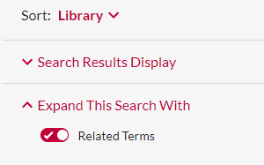
If you wish to cancel this feature, go to the LH column of the results screen and slide the Related Terms option across to turn it off.

Slide 19
Citing a Record
Revelation can also help you to create a Bibliography.

Slide 20
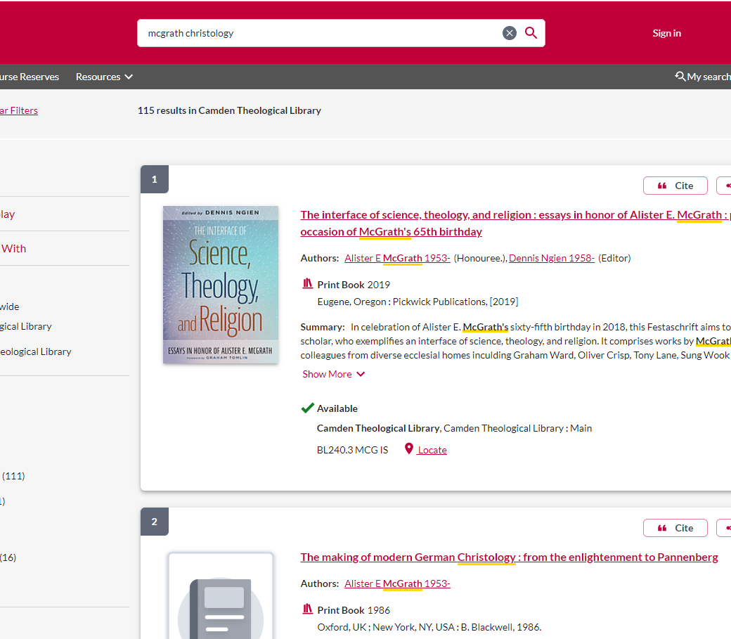
Citing a record
If you wish to include the details of a Book or Journal article in your Bibliography, click on the ‘Cite’ button in the top right-hand corner of that record

Slide 21
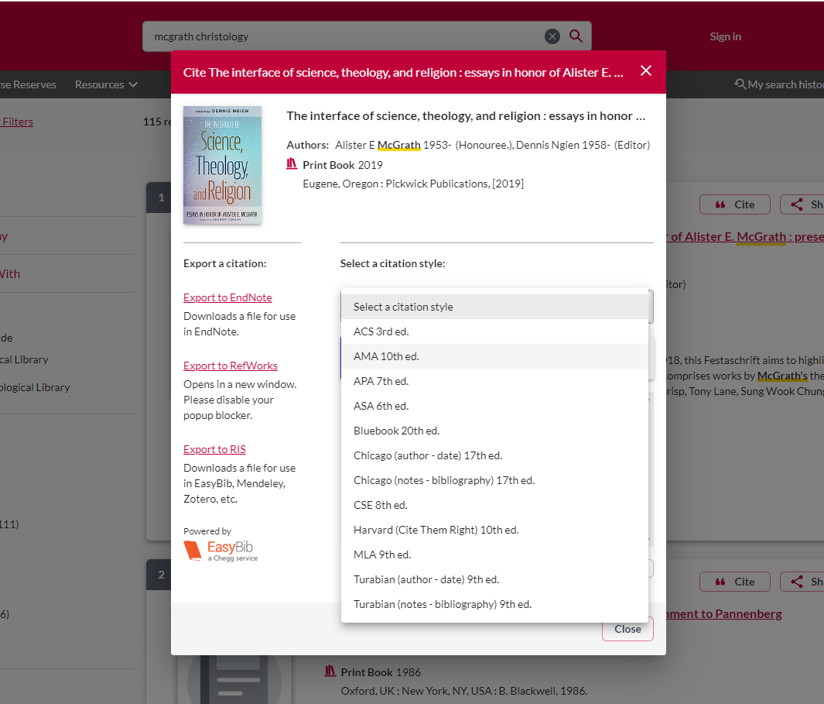
You can then choose to Add the record to either
EndNote
RefWorks
You can also select the relevant bibliographic style from the dropdown list. The one that is used for your essays at UTC is
APA 7th ed.

Slide 22
Browsing the Shelf
If you are interested in exploring a range of similar Print books in the Library collection, you can ‘Browse the Shelf’ from your computer.

Slide 23
Browsing the Shelf
If you click on the Title link in a record, a second screen opens.

Slide 24
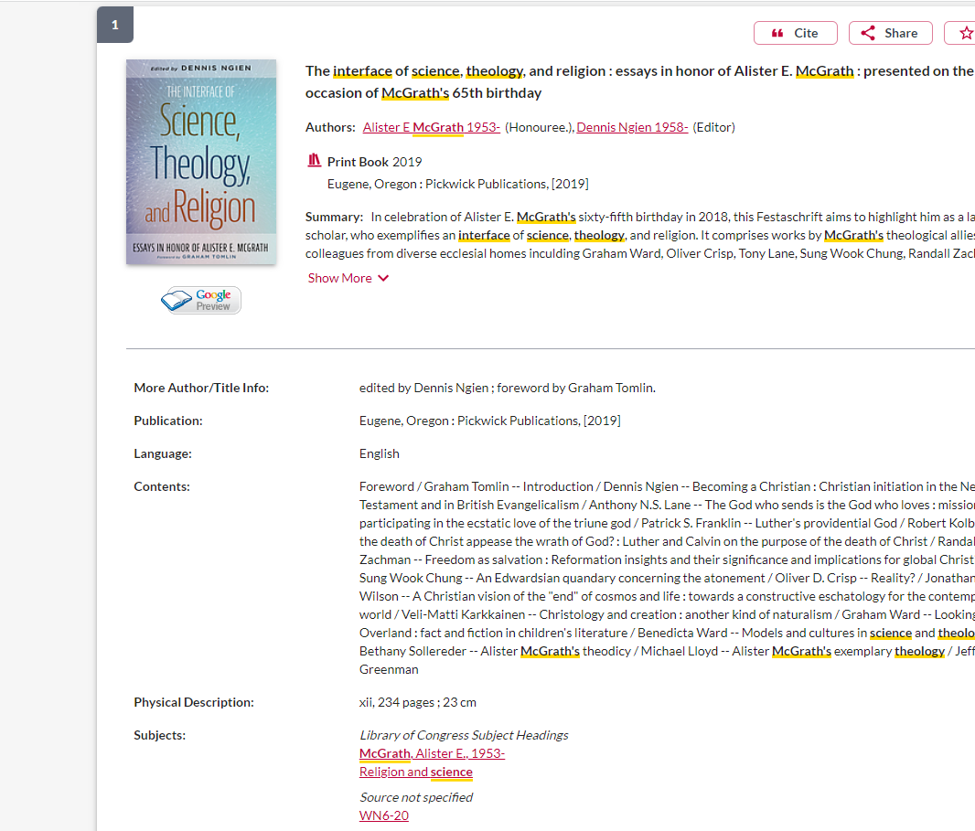
Scroll down to the bottom of this screen

Slide 25
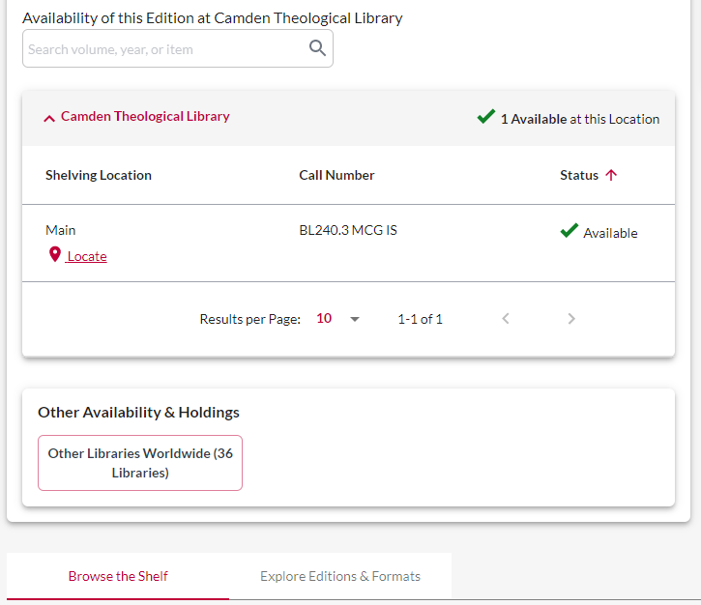
At the bottom of the record, there is an option to ‘Browse the Shelf’

Slide 26
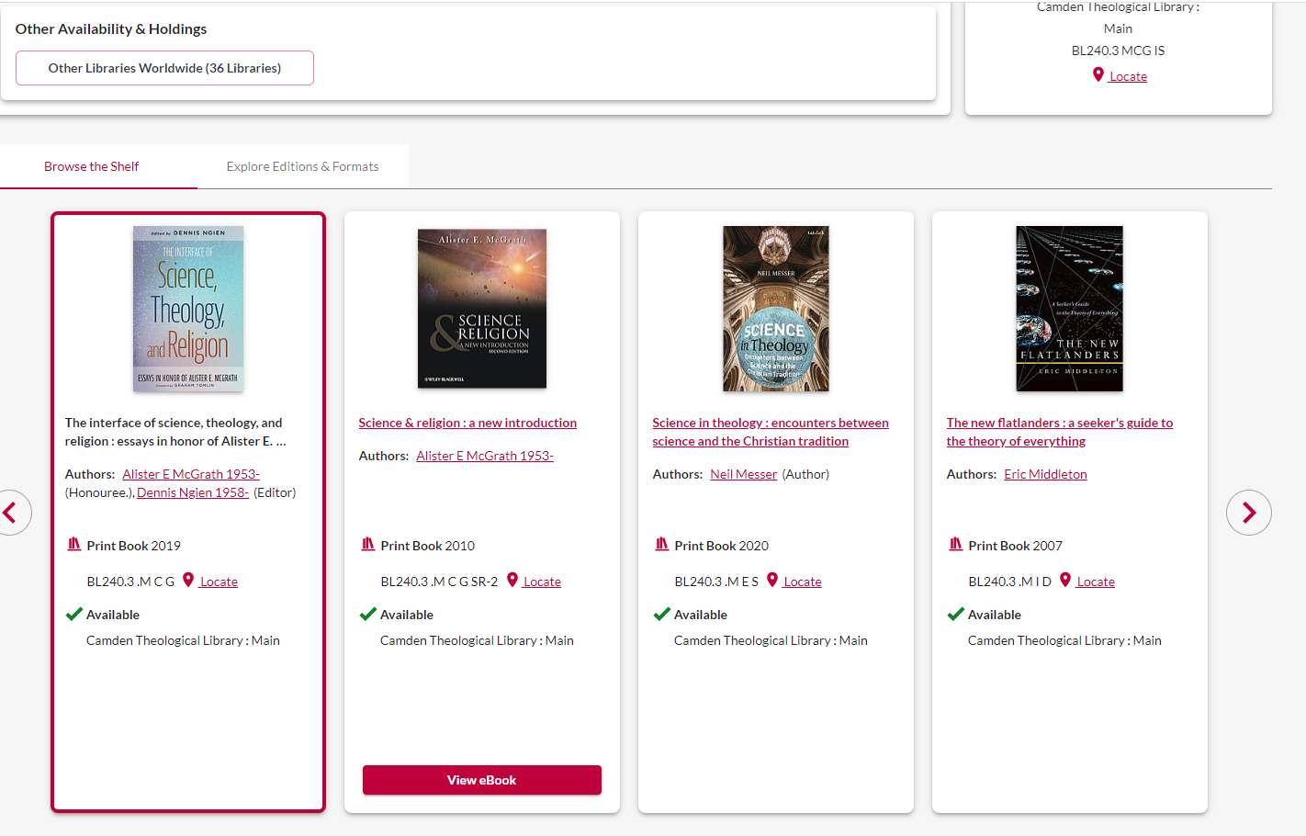
This helps you to explore the other Print books which may be of interest to you. Use the arrows to move to the left or to the right from the selected item.

Slide 27
Would you like more Help?

Slide 28
We hope this has provided you with an overview of the new version of ‘Revelation’. Please contact the Library if your need some additional assistance.
Email library@nswact.uca.org.au
Phone 02 8838 8940
You can contact the Library team by email or phone, and we will be happy to assist you

